Slide 1
Social Development
Key Study: Bandura, Ross & Ross (1961)
Transmission of aggression through imitation of aggressive models

Slide 2
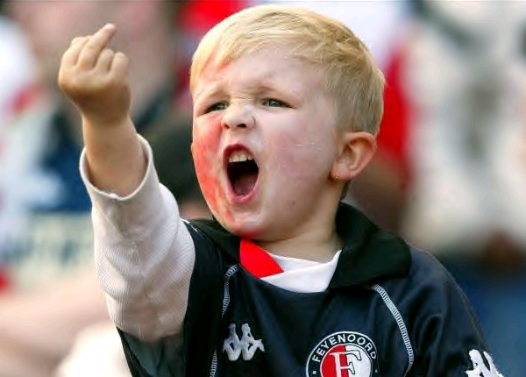
What makes a child aggressive?

Slide 3
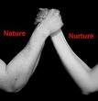
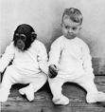

Nature vs Nurture

Slide 4
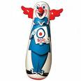
The Study
Aim: to find out if children imitate aggressive behaviour – even when in a different environment and without the model present.
Hypotheses:
1. Children will imitate the aggressive behaviour of models
Non-aggressive models will have an inhibiting effect
Same-sex model will have more influence
Boys will imitate aggression more than girls

Slide 5
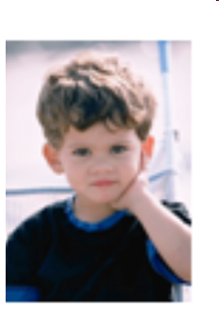
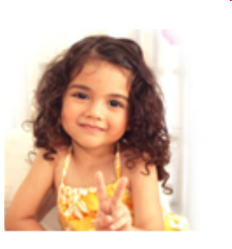
The Study
Laboratory experiment with observation.
36 boys and 36 girls from Stanford University Nursery School.
Aged 37-69 months (approx 3-5 years) with a mean age of 52 months (4⅓ years).

Slide 6
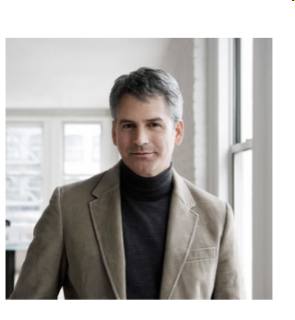
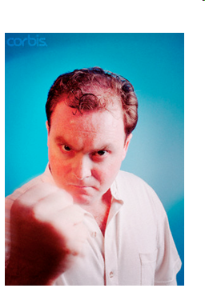
The Study
First IV; Role model
Non-aggressive model
Aggressive model
No model (control group)

Slide 7
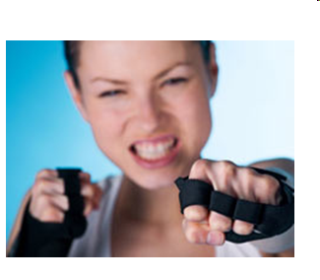


The Study
Second IV; Gender of role model
Male role model
Female role model

Slide 8
The Study
Third IV; Whether pp are male or female
Male
Female

Slide 9
Sample
72 children
24 Control group
24 Aggressive
role model
24 Non-aggressive
role model
Male
6 boys
Male
6 girls
Female
6 boys
Female
6 girls
Male
6 boys
Female
6 boys
Female
6 girls
Male
6 girls

Slide 10
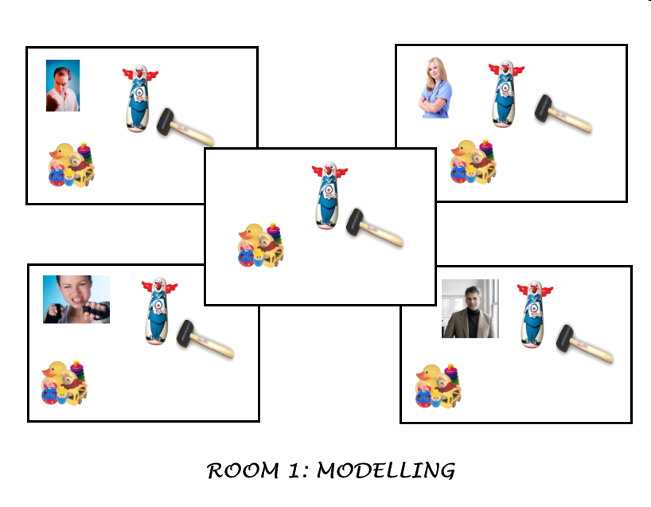
Room 1

Slide 11
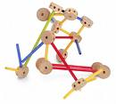
Tinker Toy Set
Tinker set that
non-aggressive
model plays with

Slide 12
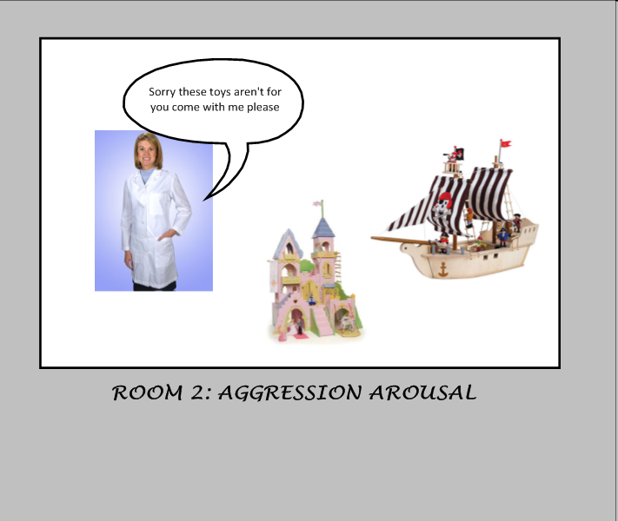
Room 2

Slide 13
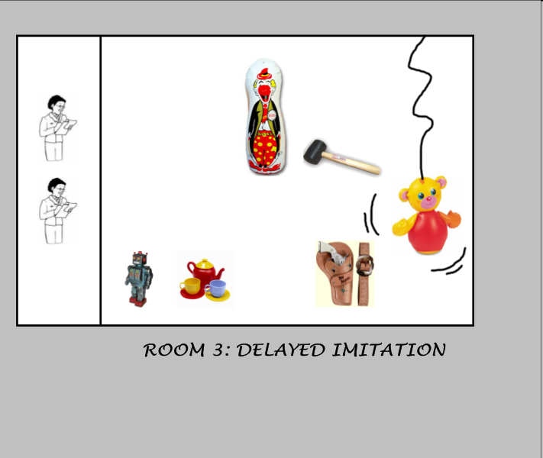
Room 3

Slide 14
Observations
Watched the child for 20 mins through one-way mirror.
Male model and independent observer watched (the latter was blind to the child’s condition).
Recorded categories every 5 seconds (240 observations for each child).

Slide 15
Dependent Variable
Imitative aggression responses:
Physical: Any acts imitated – e.g. striking Bobo with mallet, sitting on it & punching it in the nose, throwing it in the air
Verbal: Phrases imitated – “Pow”, “Sock him”, “Hit him down”, “Kick him”, “Throw him in the air”

Slide 16
Dependent Variable
2. Partially imitative responses:
Mallet aggression: Using mallet on other toys.
Sitting/bouncing on Bobo doll.

Slide 17
Dependent Variable
3. Non-imitative aggressive response:
Slapping/punching Bobo doll.
Non-imitative physical and verbal aggression.
Aggressive gun play.

Slide 18
Bandura’s study
http://www.psychexchange.co.uk/videos/view/20005/

Slide 19
The Study
Aim: to find out if children imitate aggressive behaviour – even when in a different environment and without the model present.
Hypotheses:
1. Children will imitate the aggressive behaviour of models.
Non-aggressive models will have an inhibiting effect.
Same-sex model will have more influence.
Boys will imitate aggression more than girls

Slide 20
Aggressive and non-aggressive conditions
 | Aggressive | Non-aggressive | Control
Imitative Physical | 50.9 | 4.2 | 3.2
Imitative Verbal | 32.7 | 1.4 | 2.4
Mallet | 80.2 | 26.4 | 26.6
Non-imitative | 82.6 | 57.0 | 30.7
Model
Behaviour

Slide 21
Subject and model – same or different sex
 | Aggressive | Non-aggressive | Control
Imitative Physical | M/M=25.8 M/F=12.4 F/F=5.5 F/M=7.2 | M/M=1.5 M/F=0.2 F/F=2.5 F/M=0.0 | M=2.0 F=1.2
Imitative Verbal | M/M=12.7 M/F=4.3 F/F=13.7 F/M=2.0 | M/M=0.0 M/F=1.1 F/F=0.3 F/M=0.0 | M=2.0 F=1.2
Mallet | M/M=28.8 M/F=15.5 F/F=17.2 F/M=18.7 | M/M=6.7 M/F=18.7 F/F=0.5 F/M=0.5 | M=13.5 F=13.1
Non-imitative | M/M=36.6 M/F=16.2 F/F=21.3 F/M=8.4 | M/M=22.3 M/F=26.1 F/F=7.2 F/M=1.4 | M=24.6 F=6.1
Model
Behaviour

Slide 22
Boys vs. girls
 | Aggressive | Non-aggressive | Control
Imitative Physical | ♂=38.2 ♀=12.7 | ♂=1.7 ♀=2.5 | ♂=2.0 ♀=1.2
Imitative Verbal | ♂=17.0 ♀=15.7 | ♂=1.1 ♀=0.3 | ♂=1.7 ♀=0.7
Mallet | ♂=44.3 ♀=35.9 | ♂=25.4 ♀=1.0 | ♂=13.5 ♀=13.1
Non-imitative | ♂=52.9 ♀=29.7 | ♂=48.4 ♀=8.6 | ♂=24.6 ♀=6.1
Model
Behaviour

Slide 23

Results
Children who observed the aggressive models made far more aggressive responses than the other 2 groups. This was found for all 3 measures (imitative, partial and non-imitative).
Boys showed more physical aggression, girls showed more verbal aggression.
Boys were more likely to imitate same-sex models but both sexes tended to imitate the same-sex models.

Slide 24
Analysis
This study supports Bandura’s Social Learning Theory as children did observe and directly imitate the behaviours.
The results contrast with instinct theory (Freud), i.e. ‘nature’

Slide 25
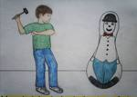
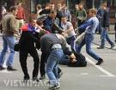
Conclusions
Is this clear evidence that aggression is learned as behaviourists would argue?
Think of arguments FOR and AGAINST social learning theory

Slide 26
Sample
Equal number of girls/boys
Matched children across 3 conditions by pre-testing aggression
Only one area/nursery – ethnocentric
Only looked at young children – would older children imitate to the same degree?

Slide 27
Ethics
Protection – was it right to subject the children to the aggressive condition?
Consent – children are unable to provide consent/fully understand experiment.
Debriefing – how would you debrief a child?

Slide 28
Strengths of method
High control over variables – i.e. actions by role model, toys in room…
Use of lab exp means children can be reliably compared between conditions.
Observed real situation so real behaviour (high ecological validity).
Inter-coder reliability (correlation r=.89)

Slide 29
Weaknesses of method
Low ecological validity – how realistic was the “aggressive” situation? Would they show aggression towards an adult?
Male model one of the observers – could be biased.

Slide 30
Evaluation
Small sample size (BUT pre-testing and matching across conditions)
Bobo doll is exciting, different, and designed for such treatment. Was that behaviour really ‘aggression’?
Long-term effects? (Hicks, 1965, says yes: 40% 6-8 months later)

Slide 31
Application
Is aggression preventable? - primary schools, prisons?
Can learning occur without behaviour?
Disinhibition: punishing a ‘naughty’ child, the adult models more aggression

Slide 32
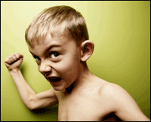
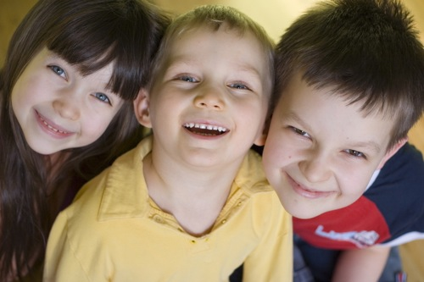
Application
Phobia therapy - +ve/-ve reinforcement
Parent training
Media – films, computer games
Phobia therapy - +ve/-ve reinforcement
Parent training
Media – films, computer games

Slide 33
Other material
http://uk.youtube.com/watch?v=sJthPwb4yMQ&feature=relate
Watson & Rayner (1920) – Little Albert – 2 minutes
http://www.youtube.com/watch?v=15HncOVohTo
Skinner – Operant conditioning – (from 0:50 to 2:18)

